Slide 1
Introduction to networking
TCP/IP Five-Layer Network Model
Joel Enrique Esparza Ramirez
Internet of Things

Slide 2
Lectures
1. Introduction to Networking
2. The Network Layer
3. The transport and application Layer
4. Wireless connections

Slide 3
Introduction to Networking
TCP/IP Five-Layer Network Model

Slide 4
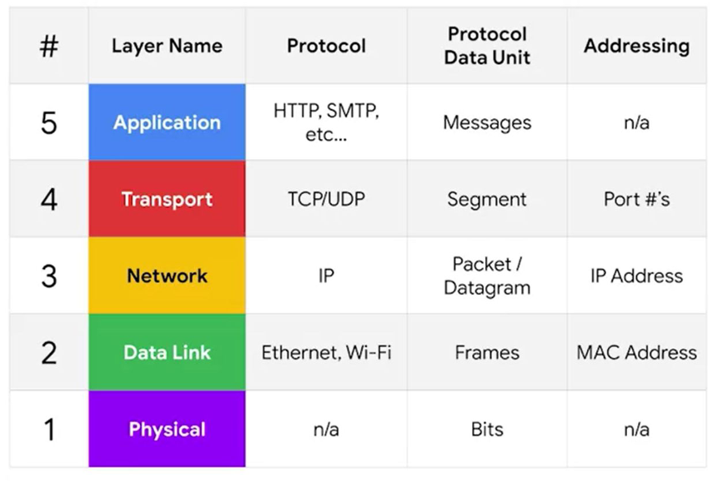
TCP/IP Five-Layer Network Model

Slide 5
Layer 1 physical
Represents the physical devices that interconnect computers

Slide 6
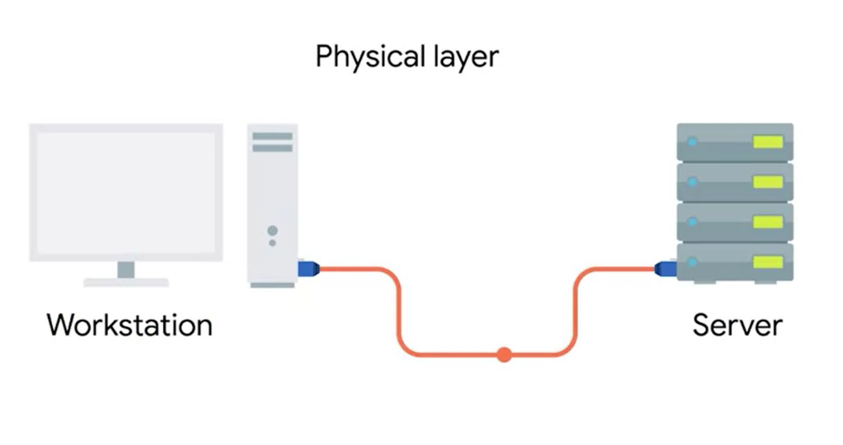

Slide 7
Layer 2 data link
Responsible for defining a common way of interesting these signals so network devices can communicate

Slide 8
ethernet
The Ethernet standards also define a protocol responsible for getting data to nodes on the same network

Slide 9
Layer 3 Network
Allows different networks to communicate with each other through devices known as routers

Slide 10
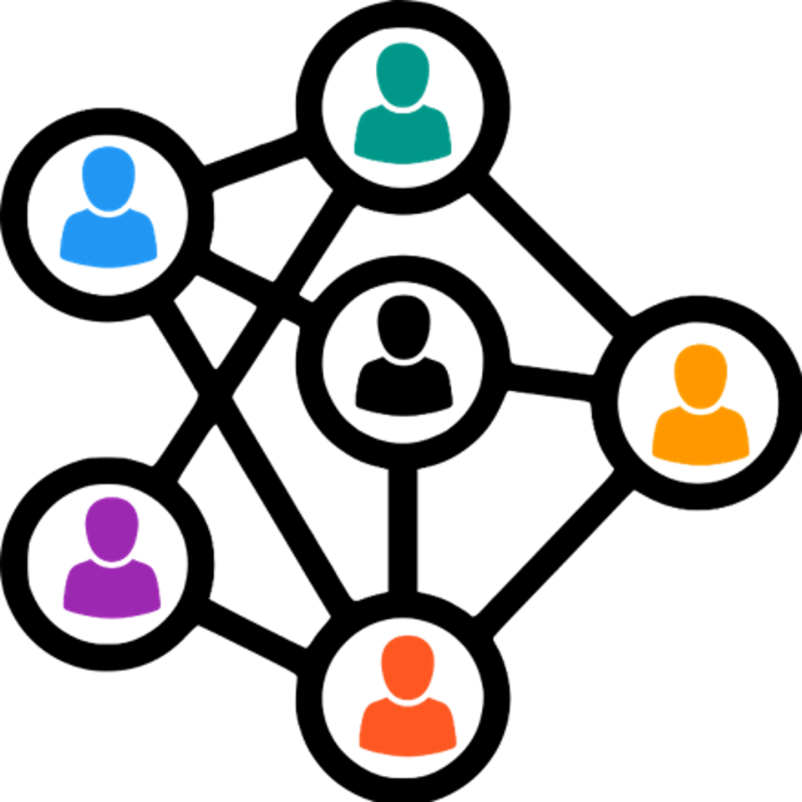

Slide 11
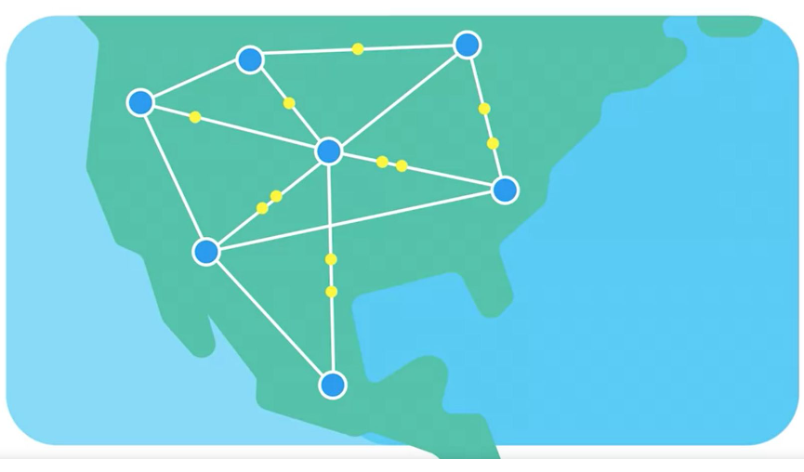

Slide 12
internetwork
A collection of networks connected together through routers, the most famous of these being the internet

Slide 13
Internet protocol
IP is the heart of the internet and most smaller networks around the world

Slide 14
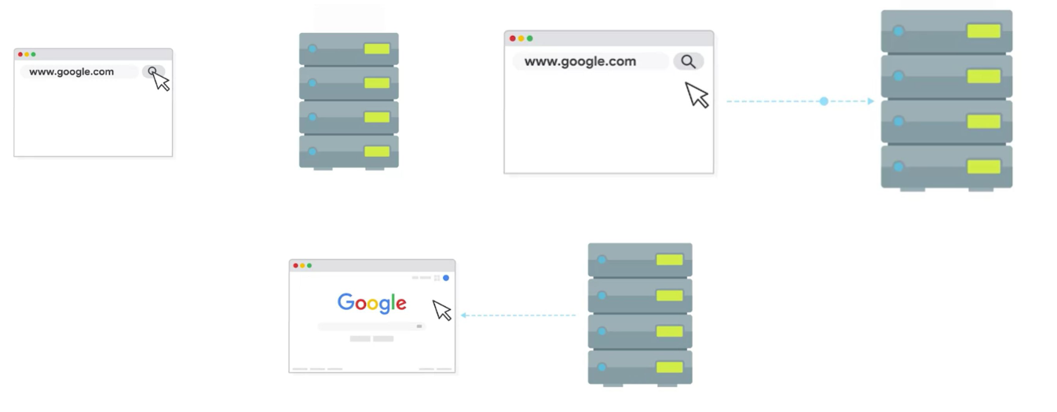
Client Server

Slide 15
Layer 4 transport
Sorts out which client and server programs are supposed to get that data

Slide 16
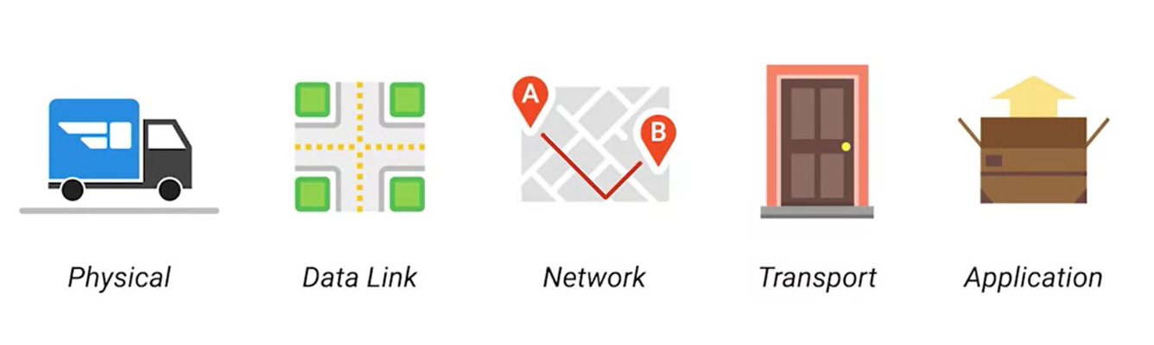

Slide 17
Osi model

Slide 18
Introduction to Networking
The basics of networking devices

Slide 19
cables
Connect different devices to each other, allowing data to be transmitted over them

Slide 20
Cables
Copper (Spanish)
Fiber (Spanish)

Slide 21
Cables
The most common forms of copper twisted-pair cables used in networking are Cat5, Cat5e and Cat6 cables

Slide 22
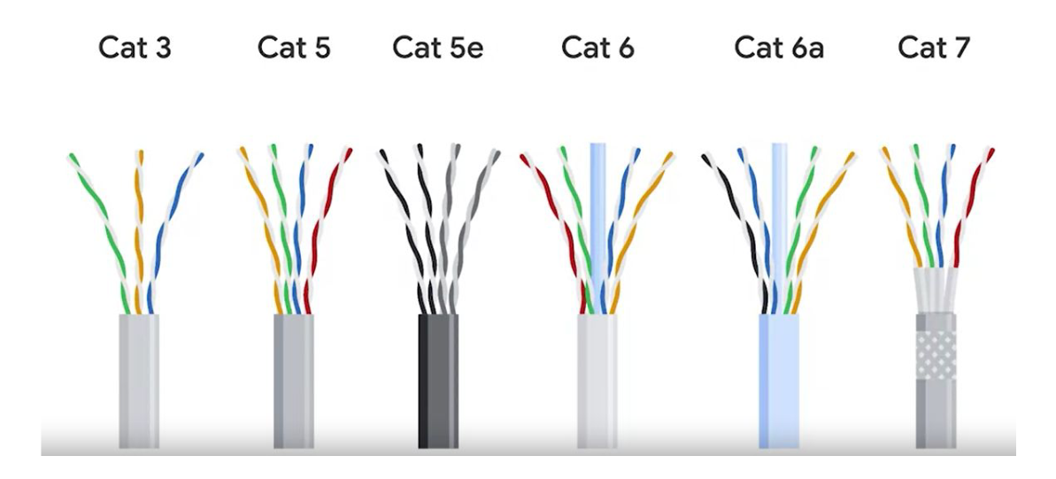

Slide 23
crosstalk
When an electrical pulse on one wire is accidentally detected on another wire

Slide 24
Fiber cables
Contain individual optical fibers, which are tiny tubes made out of glass about the width of a human hair

Slide 25
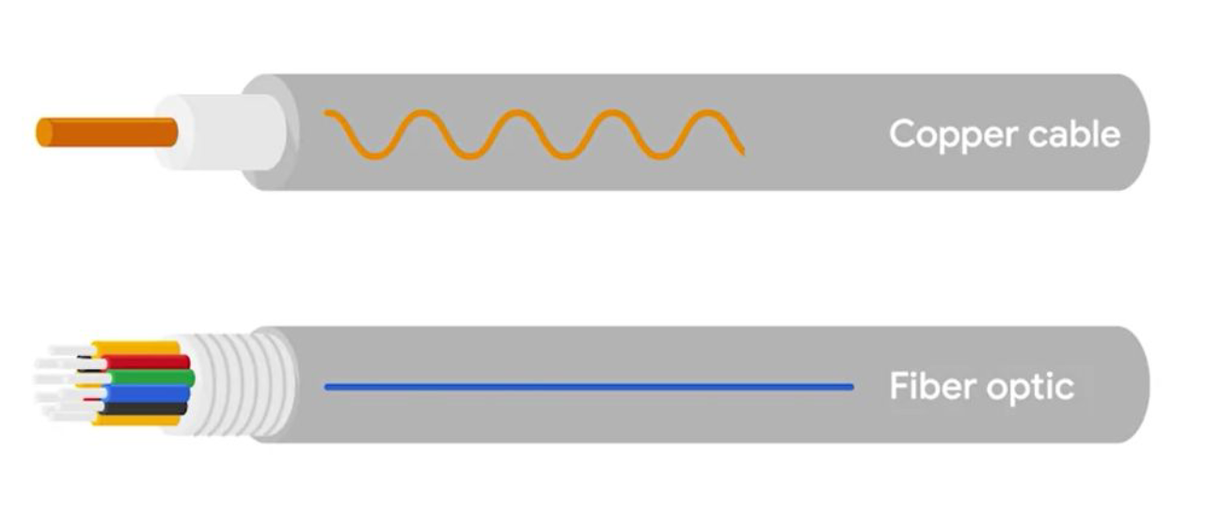

Slide 26
Recap layer 1

Slide 27
HUB
A physical layer device that allows for connections from many computers at once

Slide 28
HUB
A hub is a basic networking device that connects multiple computers or other network devices together. It operates at the physical layer (Layer 1) of the OSI model. When a data packet arrives at one port, it is copied to all other ports so that all segments of the LAN can see all packets.

Slide 29
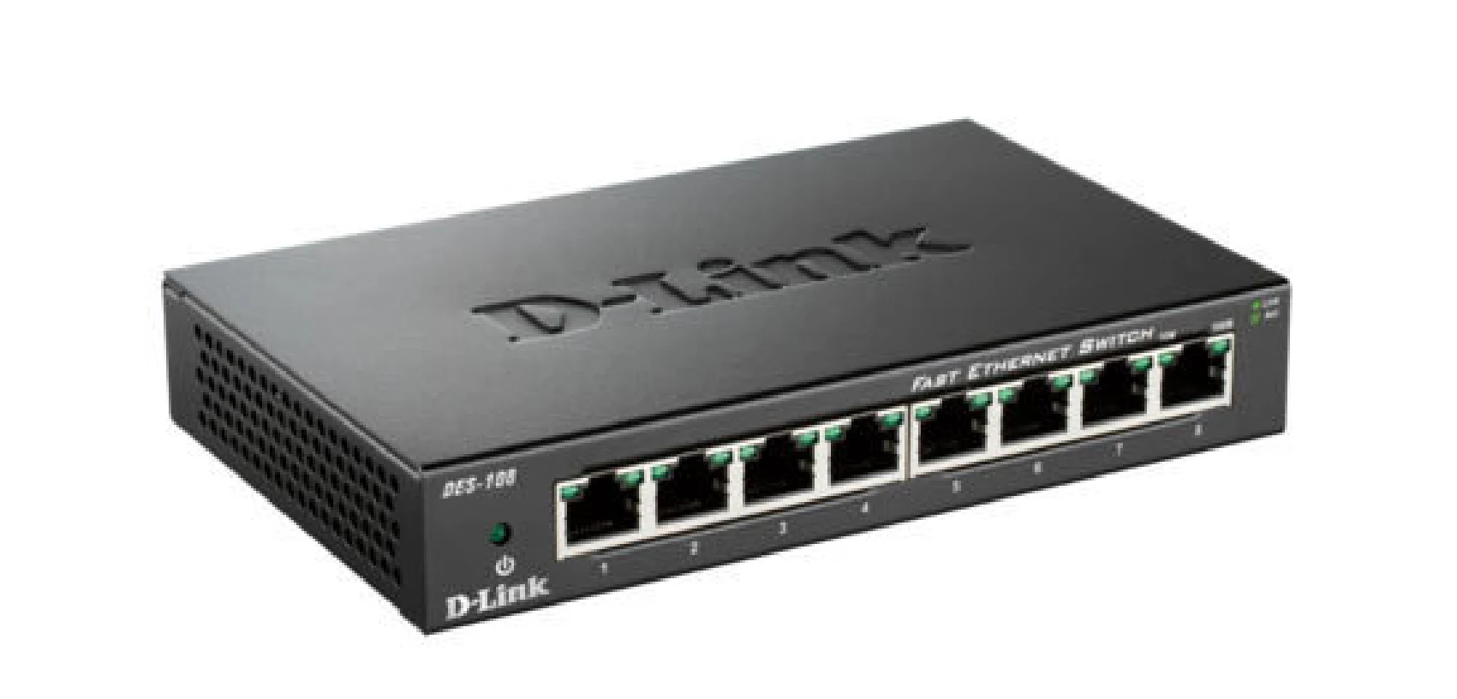

Slide 30
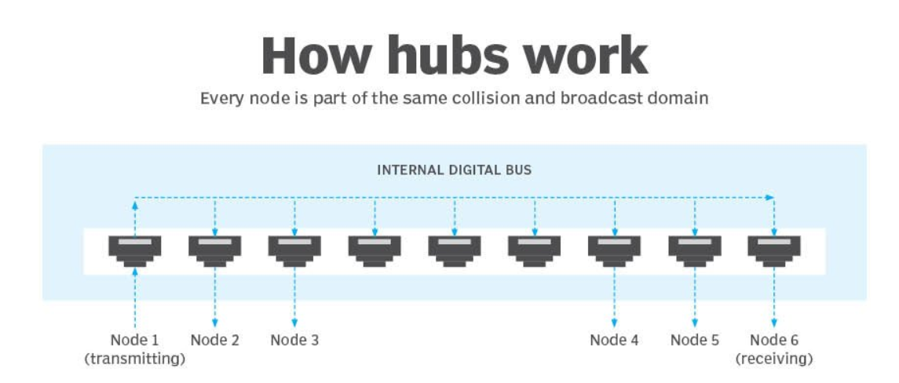

Slide 31
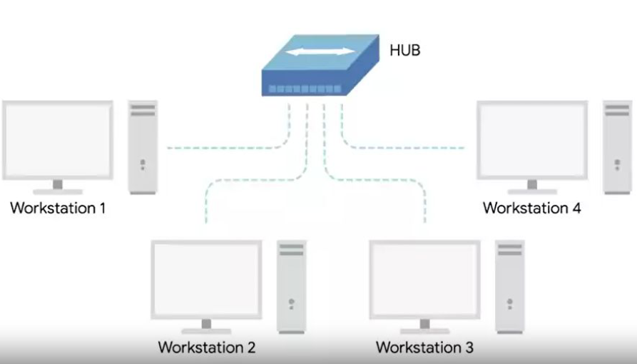

Slide 32
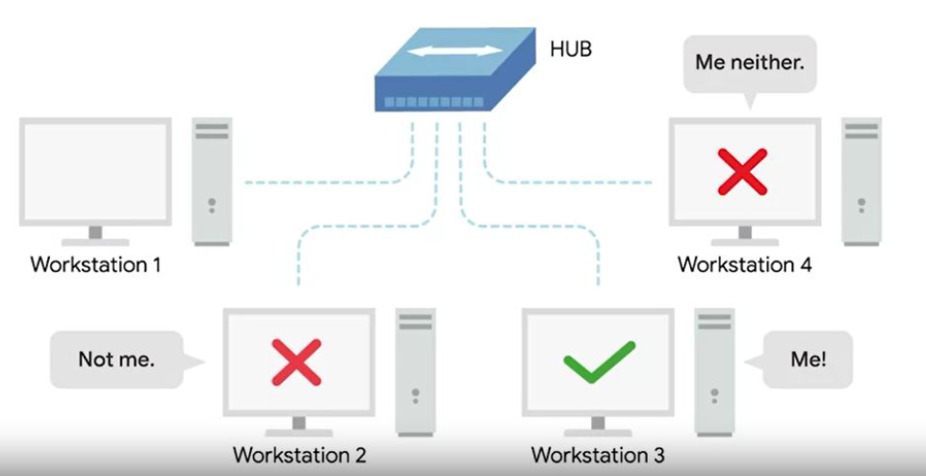

Slide 33
Collision domain
A network segment where only one device can communicate at a time

Slide 34
Collision domain
If multiple systems try sending data at the same time, the electrical pulses sent across the cable can interfere with each other

Slide 35
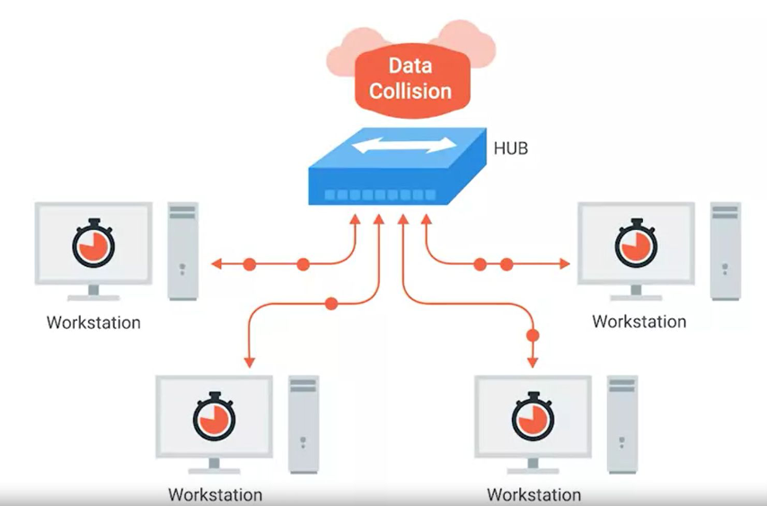

Slide 36
Switch
A switch, on the other hand, operates at the data link layer (Layer 2) of the OSI model. It is more advanced than a hub. A switch can inspect the data packets coming in and make decisions about where to send them based on their MAC addresses. Essentially, it can direct packets only to the device that is meant to receive them, rather than broadcasting to all devices.

Slide 37
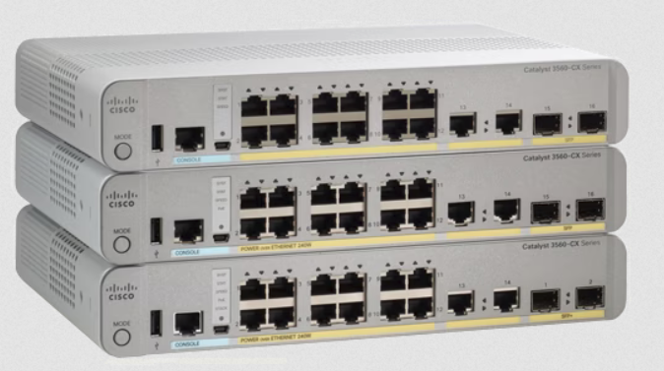
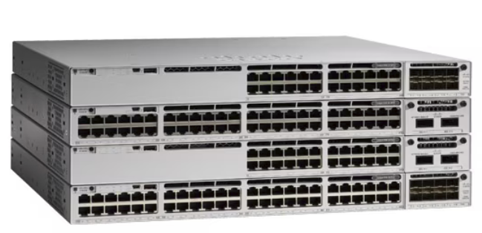

Slide 38
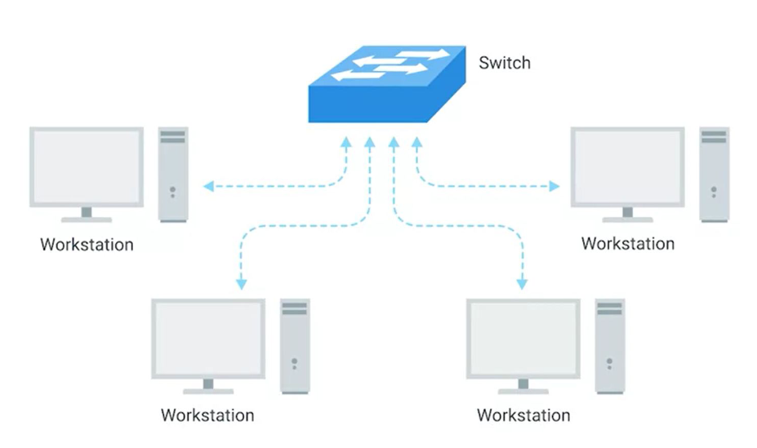

Slide 39
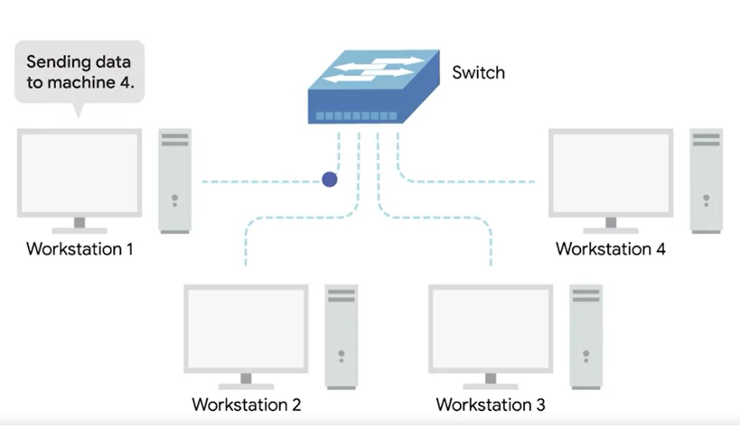

Slide 40
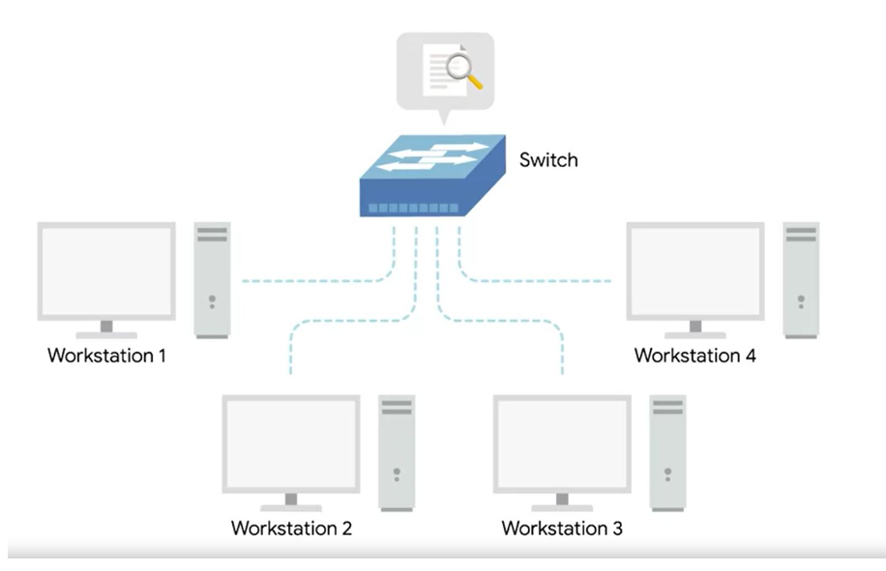

Slide 41
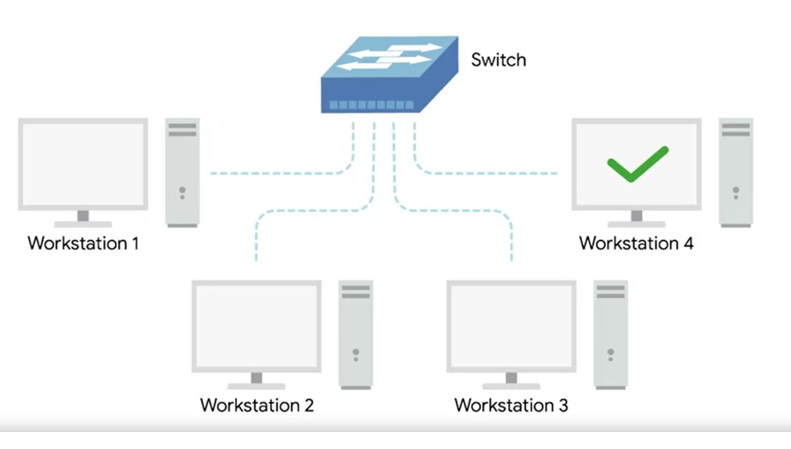

Slide 42
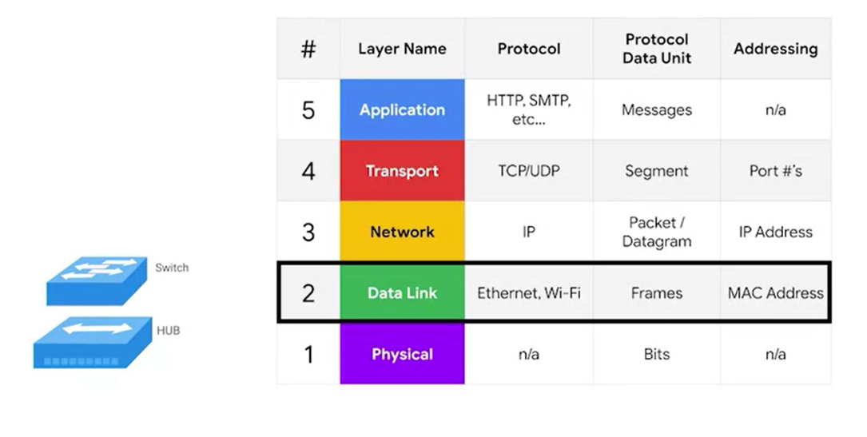

Slide 43
Hub and switches
The primary devices used to connect computers on a single network. Usually referred as a LAN, or local area network

Slide 44
recap

Slide 45
router
A device that knows how to forward data between independent networks

Slide 46
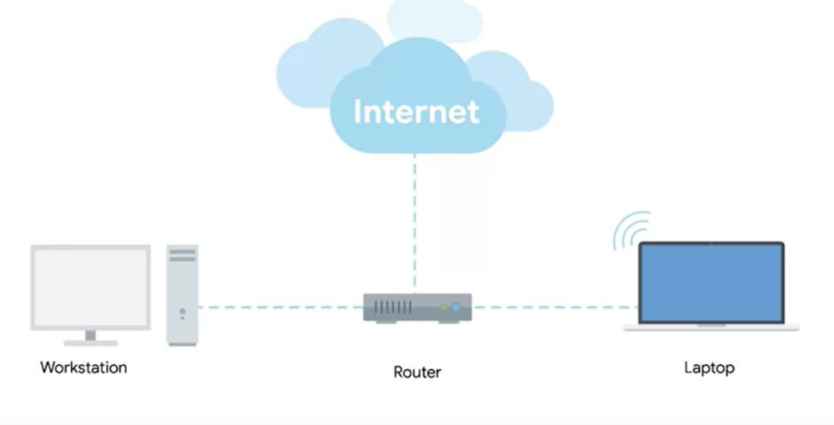

Slide 47
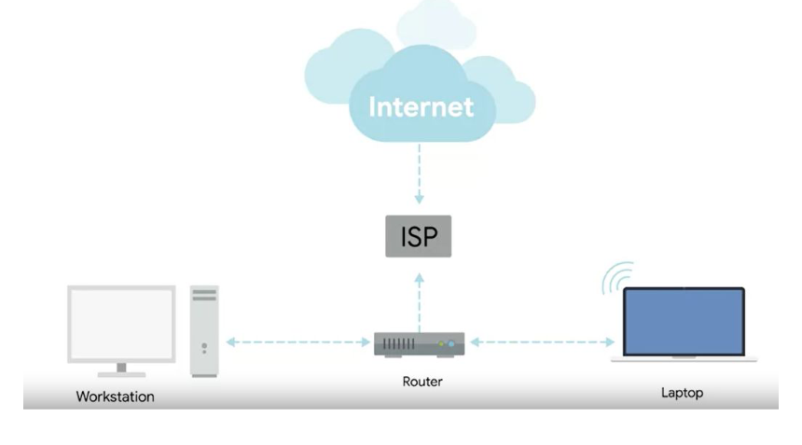
Internet service provider

Slide 49
Border gateway protocol (BGP)
Routers share data with each other via this protocol, which lets them learn about the most optimal paths to forward traffic.

Slide 50
NODE
A device connected to the network

Slide 51
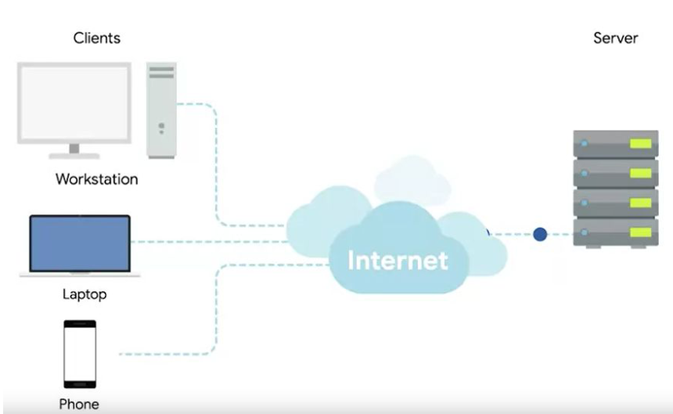

Slide 52
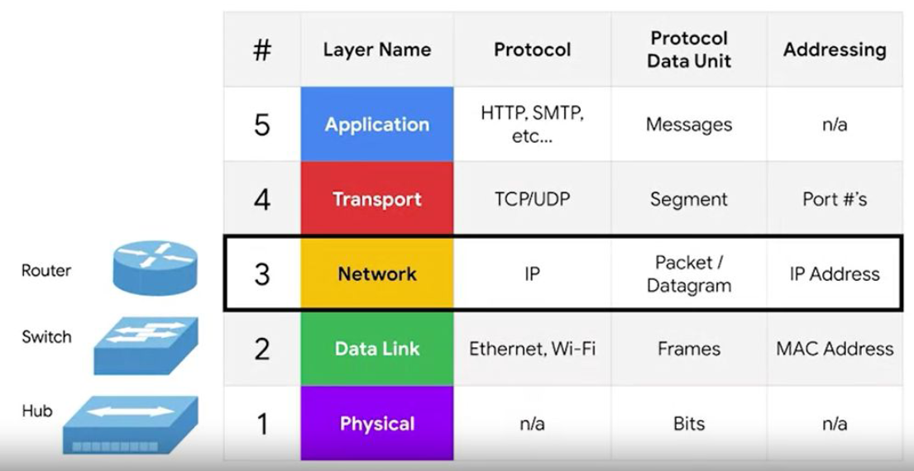

Slide 53
The physical layer
Layer 1

Slide 54
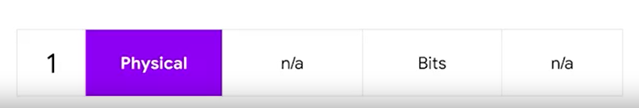

Slide 55
bit
In communication systems, a bit (binary digit) serves as the fundamental unit of data. It represents the smallest piece of information that can be transmitted or processed, which is either a 0 or a 1. These two values correspond to different states, such as on/off, true/false, or any other binary opposition, and are used in various encoding and modulation schemes to represent and convey information over communication channels.

Slide 56
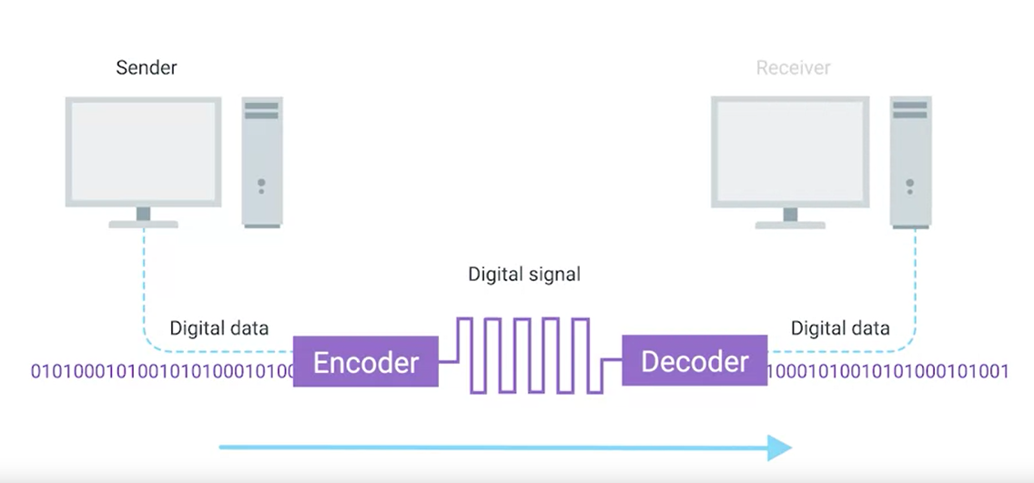
modulation
A way of varying the voltage of this charge moving across the cable

Slide 57
Twisted pair cable
The most common type of cabling used for connecting computing devices
It features pair of copper wires that are twisted together

Slide 58
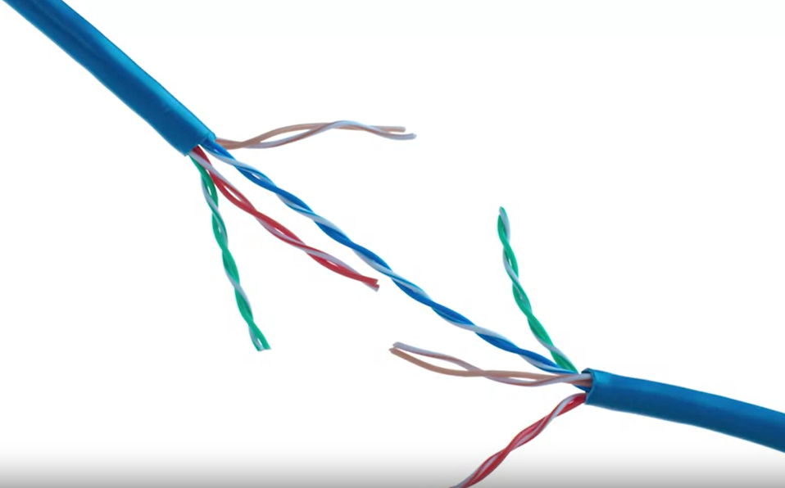

Slide 59
Duplex communication
The concept that information can flow in both directions across the cable

Slide 60
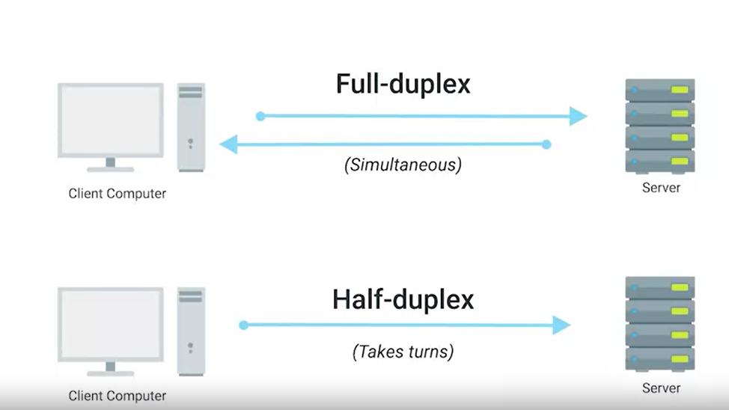

Slide 61
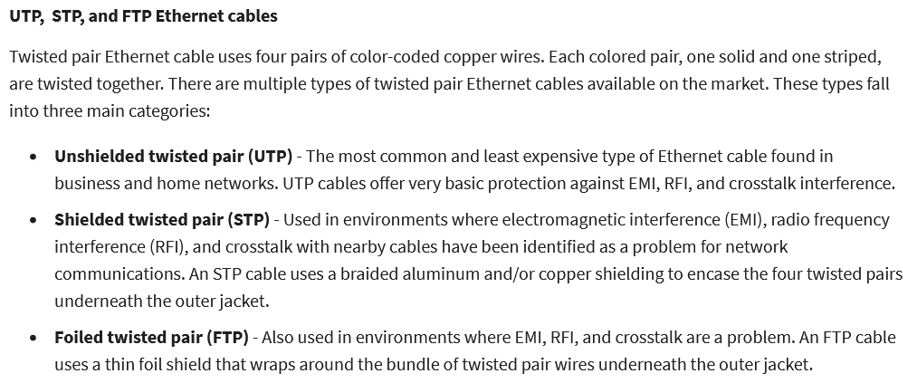

Slide 62
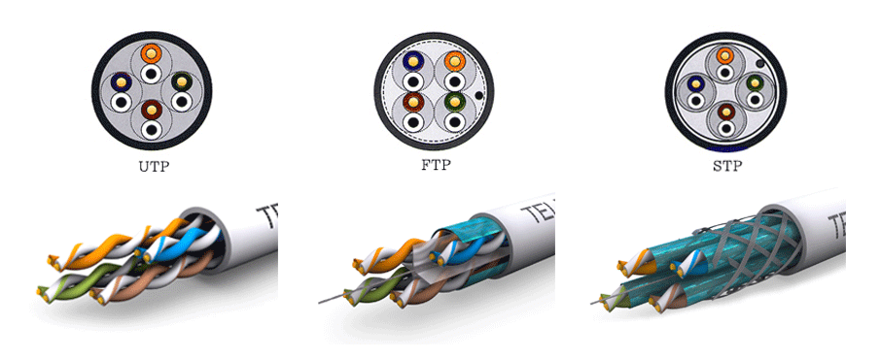

Slide 63
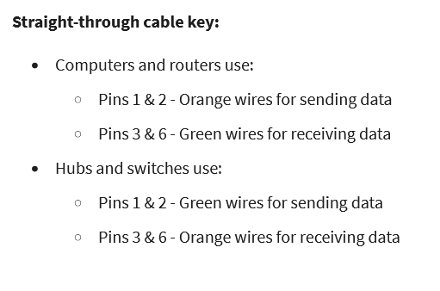

Slide 64
T568A/ T568B
T568A Configuration:
Green pair is placed at pins 1 and 2 (White/Green, Green)
Orange pair is placed at pins 3 and 6 (White/Orange, Orange)
T568B Configuration:
Orange pair is placed at pins 1 and 2 (White/Orange, Orange)
Green pair is placed at pins 3 and 6 (White/Green, Green)

Slide 65
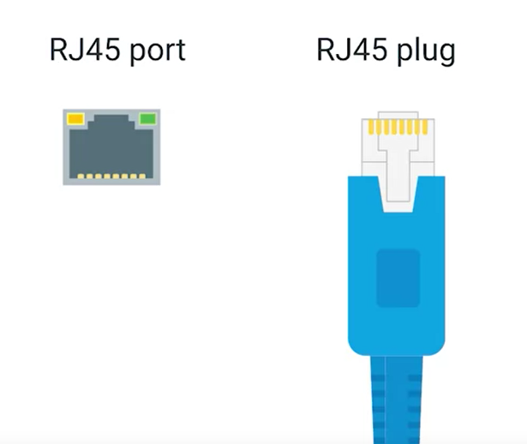
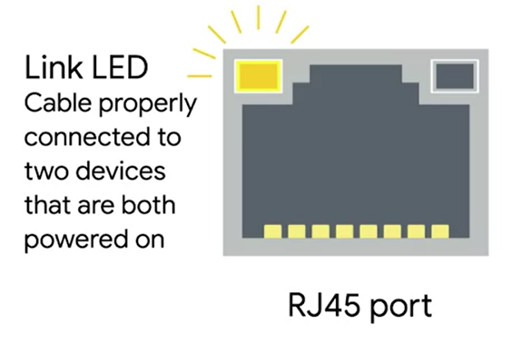
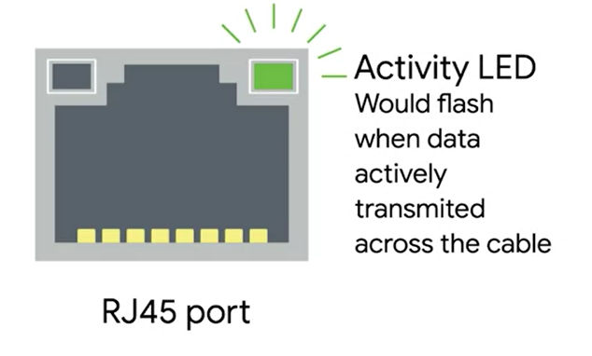
Network ports

Slide 66
DATA LINK layer
Layer 2

Slide 67
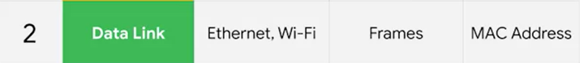

Slide 68
ETHERNET
Ethernet is widely used in various network setups, from simple home networks connecting a few devices to complex corporate data centers with thousands of connections. It provides a reliable and standardized way to network devices with different capabilities.

Slide 69
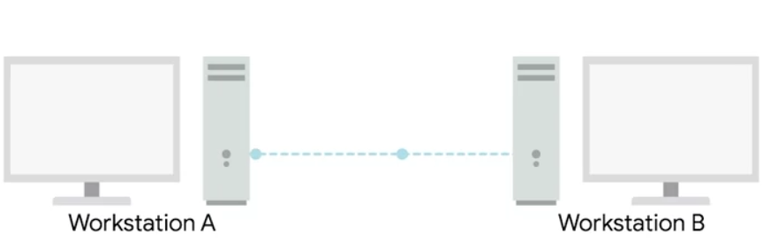
CSMA/CD
Carrier Sense Multiple Access with Collision Detection (CSMA/CD) is a network protocol for carrier transmission that is used in Ethernet networks to control access to the network medium. It's a fundamental part of the Ethernet standard for handling situations where two or more devices attempt to send data at the same time, leading to a collision.

Slide 70
NIC
A Network Interface Card (NIC), also known as a network card, network adapter, or LAN adapter, is a piece of computer hardware designed to allow computers to communicate over a computer network. It provides the physical interface between a computing device and the network cable, and it is a critical component for establishing a network connection.

Slide 71
MAC
A MAC address, short for Media Access Control address, is a unique identifier assigned to network interfaces for communications on the physical network segment. MAC addresses are used as a network address for most IEEE 802 network technologies, including Ethernet and WiFi. Essentially, it helps in ensuring that the physical devices in a network can be uniquely identified and communicated with.

Slide 72
FORMAT
A MAC address is typically a 48-bit (6-byte) or, in some cases, a 64-bit (8-byte) number. The 48-bit address is most commonly used and is represented in hexadecimal notation, divided into pairs (e.g., 00:1A:2B:3C:4D:5E).

Slide 73
Assignment
MAC addresses are usually assigned to the network interface card (NIC) by the manufacturer at the time of production, and thus they are also referred to as hardware addresses or physical addresses. The first half of the MAC address represents the manufacturer's unique identifier (also known as the Organizationally Unique Identifier - OUI), and the second half is the serial number assigned by the manufacturer.

Slide 74
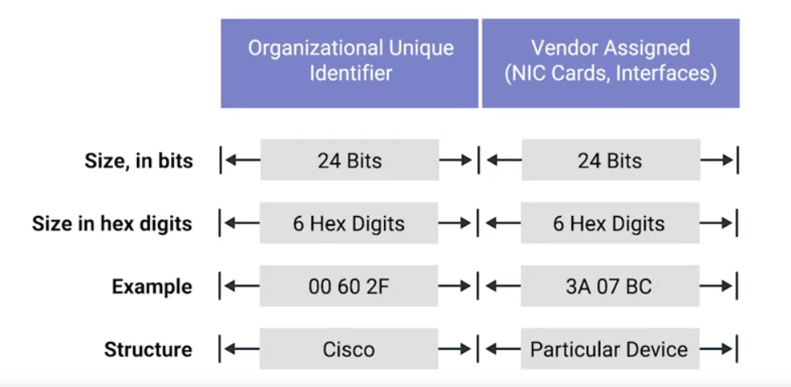

Slide 75
ETHERNET MAC
Ethernet uses MAC addresses to ensure that the data is sends has both and address for the machine that sent the transmission, as well as the one the transmission was intended for.

Slide 76
Unicast
Unicast is a one-to-one type of communication. In unicast, data packets are sent from a single source to a single destination with a unique address. It is the most common form of data transmission on the Internet.

Slide 77
Multicast
Multicast is a one-to-many type of communication. In multicast, data packets are addressed to a specific group of destination computers simultaneously. Only the devices that have joined a specific multicast group will receive the multicast packets.

Slide 78
Broadcast
Broadcast is a one-to-all communication method. In broadcast, data packets are sent from a single source to all possible destinations within the network segment or domain. Every device on the network receives the broadcast packets but only processes them if they are of interest; otherwise, they are discarded.

Slide 79
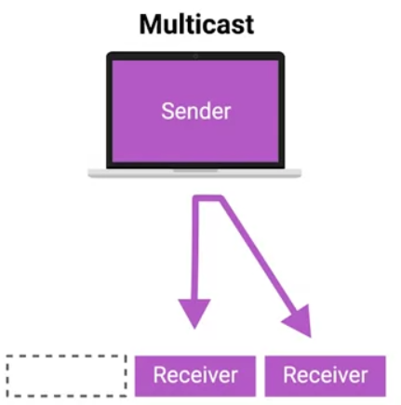
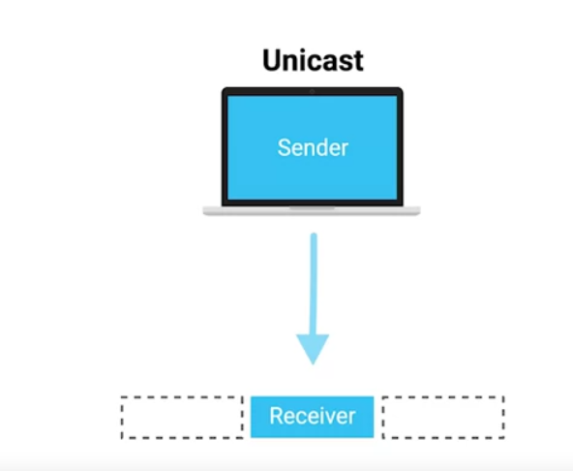
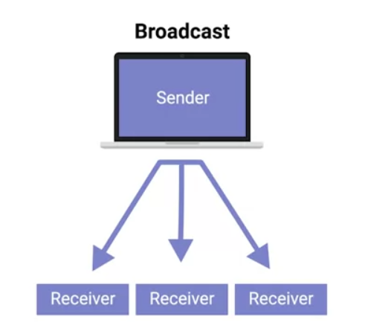

Slide 80
DATA PACKET
A data packet, often simply referred to as a "packet," is a formatted unit of data carried by a packet-switched network. In the context of computer networks, a packet is a small segment of a larger message or stream of data that’s transmitted over a network.

Slide 81
ETHERNET FRAME
An Ethernet frame is a specific structure used for framing data packets in Ethernet networks. It encapsulates the data packet for transmission over an Ethernet link. The frame structure is defined by various IEEE standards, with the most common being IEEE 802.3.

Slide 82
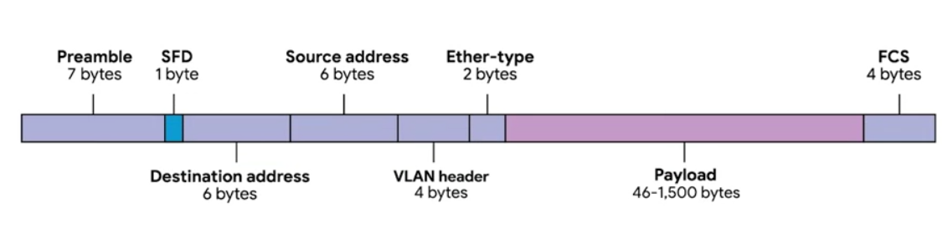

Slide 83
Preamble and Start Frame Delimiter (SFD)
Preamble (7 bytes): A sequence of alternating 1s and 0s that allows devices on the network to easily synchronize their receiver clocks, providing a buffer to establish bit-sync for the actual frame.
Start Frame Delimiter: Signals the beginning of the frame data with a specific byte pattern (10101011), marking the end of the preamble and the start of the Ethernet frame.

Slide 84
Destination MAC Address
The Media Access Control (MAC) address of the intended recipient of the frame. This could be a unicast (single device), multicast (group of devices), or broadcast (all devices) address.

Slide 85
Source MAC Address
The MAC address of the sender of the frame. This is used by the receiving device to know where the frame originated from.

Slide 86
EtherType/Length
EtherType: When used as EtherType, this field indicates the protocol of the encapsulated data packet, allowing the receiving device to properly interpret the payload.
Length: Alternatively, it can signify the length of the payload in bytes.

Slide 87
Payload
The actual data being transported. This includes any headers for other protocols carried within the Ethernet frame, such as an IP packet.

Slide 88
Frame Check Sequence
A cyclic redundancy check (CRC) used for error checking. The FCS allows the receiver to detect some types of errors in the transmission. If the FCS does not match the calculated value, the frame is discarded.

Slide 89
NETWORK layer
Layer 3

Slide 90
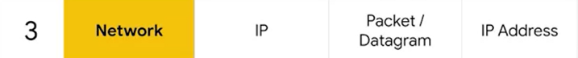

Slide 91
IP
The Internet Protocol (IP) is a set of rules governing the format of data sent over the Internet or other networks. IP is a fundamental protocol within the Internet protocol suite, which is a collection of networking protocols that includes TCP, UDP, and many others.

Slide 92
IP
Dynamic
Static

Slide 93
Static IP Addresses
A static IP address is a fixed address that is manually assigned to a device and does not change over time. Once a device is assigned a static IP address, that address remains the same until it is manually changed, or the device is removed from the network.

Slide 94
Usage
Static IP addresses are typically used for devices that need to maintain the same IP address for an extended period, such as servers, network printers, or other devices that need to be reliably accessed by the same IP address. They are also used for DNS servers, VPN gateways, and devices that require remote access.

Slide 95
Dynamic IP Addresses
A dynamic IP address is assigned to a device for a limited period or until the device disconnects from the network, using a DHCP server. When the lease for an IP address expires, the device may be assigned a new IP address.

Slide 96
Usage
Dynamic IP addresses are commonly used for consumer devices, such as personal computers, smartphones, and tablets connected to a residential internet connection, or devices in corporate environments that do not require permanent IP addresses.

Slide 97
IPV4
IPv4, or Internet Protocol version 4, is the fourth revision of the Internet Protocol (IP) and a widely used protocol in data communication over different kinds of networks. IPv4 is the first version of the protocol to be widely deployed, and it forms the basis for most of the Internet's current architecture.

Slide 98
32-bit Addressing
IPv4 addresses are 32 bits long, which allows for a theoretical maximum of about 4.3 billion unique addresses (2^32). However, large blocks of addresses are reserved for special uses and cannot be allocated for public internet routing, reducing the number of addresses available for general use.

Slide 99
Address Notation
IPv4 addresses are typically expressed in dotted-decimal format, which divides the 32-bit address into four 8-bit fields. Each field is then represented as a decimal number (ranging from 0 to 255) and separated by periods. For example, 192.168.1.1 is a standard representation of an IPv4 address.

Slide 100
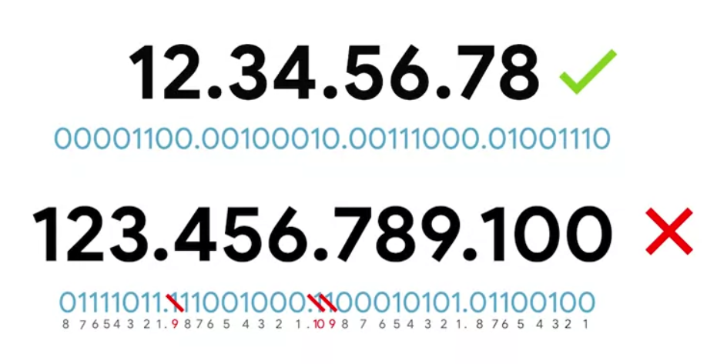

Slide 101
IP ADDRESSES
IP addresses can be split into two sections:
The network ID and the host ID

Slide 102
Address class system
A way of defining how the global IP address space is split up.
Class A
Class B
Class C

Slide 103
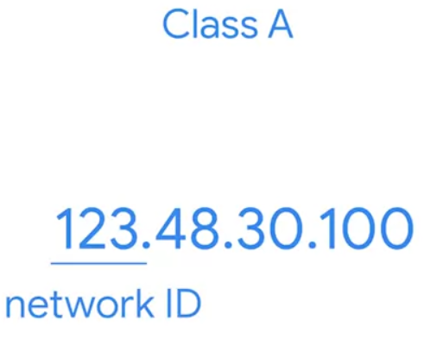
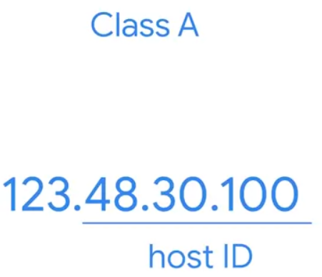

Slide 104
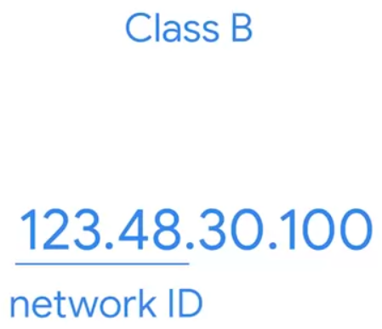
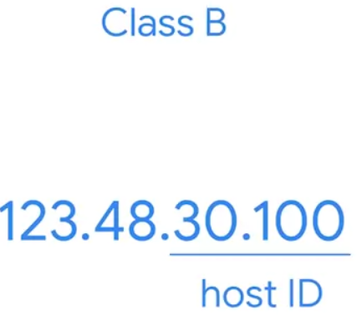

Slide 105
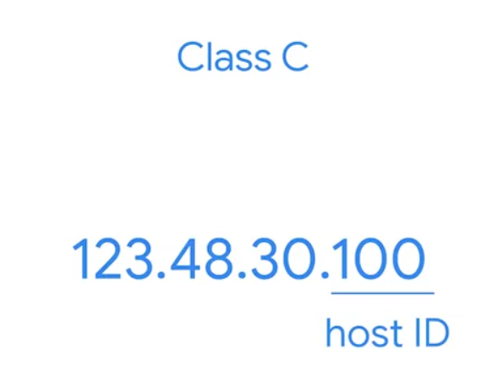
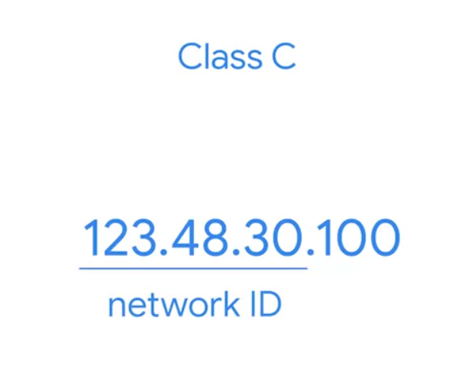

Slide 106
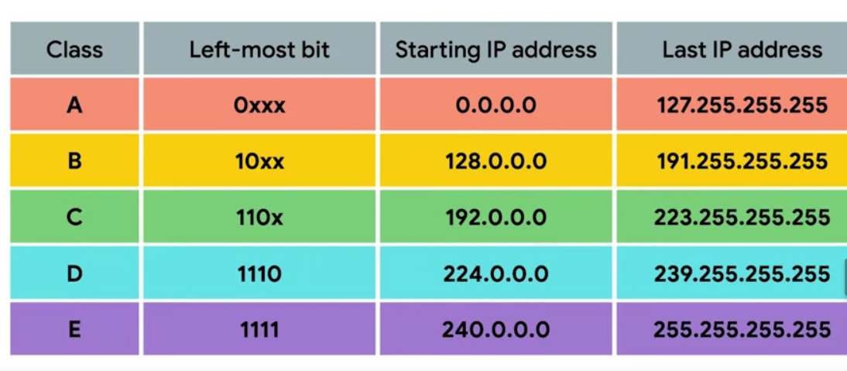

Slide 107
ARP
The Address Resolution Protocol (ARP) is a fundamental protocol used in the IP networking of IPv4 networks. ARP's primary function is to map an IP address to its corresponding physical (MAC) address on a local area network (LAN).

Slide 108
How ARP Works
When a device wants to find the MAC address associated with an IP address, it broadcasts an ARP request on the network.
The request contains the IP address for which the MAC address is sought.
All devices on the local network segment receive the ARP request, but only the device that owns the IP address will respond with an ARP reply. This reply includes the MAC address that corresponds to the IP address in question.
The requesting device receives this reply and can now send packets to the destination device.

Slide 109
ARP TABLES
Each device on the network maintains an ARP table, which is a cache of IP-to-MAC address mappings for some period of time. This cache includes entries for devices it has interacted with recently, preventing the need for an ARP request for each packet sent.
The ARP table typically contains columns for the IP address, the corresponding MAC address, the type of mapping (static or dynamic), and the time to live (TTL) or age of the entry.

Slide 110
Managing ARP Tables:
Network administrators can view and manipulate ARP tables using various network utilities:
On Windows, the command arp -a displays the current ARP table.
On Linux and macOS, the same can be achieved with the command arp -n or ip neigh.

Slide 111
subnetting
Subnetting is a crucial concept in networking that involves dividing a larger network into smaller, manageable segments called subnets. This process enhances network performance and security while enabling better management of IP addresses

Slide 112
Subnetting
Efficient IP Address Allocation: Without subnetting, an organization might use a single network address for all its devices, leading to inefficient use of IP addresses. Subnetting allows the network to be divided into smaller sections, using IP addresses more efficiently.
Improved Network Performance: By breaking down a large network into smaller subnets, broadcast traffic is reduced, and network congestion is minimized, improving overall performance.

Slide 113

Subnet mask

Slide 114


Slide 115
CIDR Notation (Classless Inter-Domain Routing):
A method used to specify IP addresses and their associated routing prefix. It's shown as the IP address, followed by a slash, and then the number of bits in the network prefix (e.g., 192.168.1.0/24)

Slide 116

CIDR

Slide 117
Router
A router is a networking device that forwards data packets between computer networks. Routers perform the traffic directing functions on the Internet or within private networks. Data sent through the internet, such as a web page or email, is in the form of data packets. A router is connected to at least two networks, commonly two LANs (Local Area Networks), two WANs (Wide Area Networks), or a LAN and its ISP’s network

Slide 118
Functions of a Router
Traffic Direction: Routers analyze the data packets sent across a network, determine their source and destination, and decide the best path for them to travel to reach their destination.
Packet Switching: They switch traffic based on TCP/IP or other network layer protocol addresses. It allows multiple devices to use the same internet connection and can prioritize traffic for better service for certain applications or devices.
Network Bridging: Routers can also perform functions similar to network bridges, connecting multiple networks and managing traffic between them.
Firewall and Security: Modern routers often include firewall and security features to protect the network from potential threats.

Slide 119


Slide 120


Slide 121


Slide 122


Slide 123


Slide 124
tracert
Tracert (on Windows) or traceroute (on Unix/Linux-based systems) is a command-line utility used to determine the path packets take to reach a target IP address or hostname on the network. This tool is commonly used for diagnosing routing issues and understanding the network's structure between the source and the destination.

Slide 125
IANA
The Internet Assigned Numbers Authority (IANA) is a key part of the global coordination of the Internet Protocol (IP) addressing system, as well as the Autonomous System Numbers used for routing Internet traffic.

Slide 126
IPv4 Private Address Spaces
10.0.0.0 to 10.255.255.255 (10.0.0.0/8): This is the largest block and is often used for a wide range of applications in large networks.
172.16.0.0 to 172.31.255.255 (172.16.0.0/12): This block is of medium size, suitable for use in entities that require a good number of private IPs but do not need as many as provided by the 10.0.0.0/8 block.
192.168.0.0 to 192.168.255.255 (192.168.0.0/16): This is the smallest block and is widely used in small networks, like home and small business networks.

Slide 127


Slide 128
IP datagram
An IP datagram is a basic unit of information passed across the Internet Protocol (IP) networks. It's essentially a structured chunk of data that includes both control information and user data, the latter of which is often referred to as the payload.

Slide 129


Slide 130
Protocol
TCP
UDP

Slide 131
TRANSPORT layer
Layer 4

Slide 132


Slide 133


Slide 134


Slide 135
TCP (Transmission Control Protocol
TCP is a connection-oriented protocol that provides reliable, ordered, and error-checked delivery of a stream of bytes between applications. It is used when the accuracy of data transmission is critical, such as in web browsing, email, and file transfers.

Slide 136


Slide 137
Three-Way Handshake
The Three-Way Handshake is a fundamental process used in TCP (Transmission Control Protocol) to establish a reliable connection between a client and a server. It involves three steps: SYN, SYN-ACK, and ACK, executed before any actual data transmission begins. This handshake ensures that both the client and the server agree to establish a connection, thus setting the stage for a reliable, ordered, and error-checked data transmission.

Slide 138
SYN (Synchronize)
The client initiates the connection by sending a TCP segment with the SYN (synchronize) flag set to the server.
This segment includes an initial sequence number (ISN), which is a random number that marks the beginning of the sequence numbers for the data that the client intends to send.

Slide 139
SYN-ACK (Synchronize-Acknowledgment)
Upon receiving the SYN segment, the server responds with its own TCP segment. This response has both the SYN and ACK (acknowledgment) flags set.
The acknowledgment number sent back is one more than the received initial sequence number from the client (client's ISN + 1). This tells the client that the server is ready to receive data starting from that number.
The server also sends its own initial sequence number, which will be used for the sequence numbers of the data the server intends to send to the client.

Slide 140
ACK (Acknowledgment)
The client acknowledges the server's response by sending an ACK segment.
The acknowledgment number in this segment is one more than the server's initial sequence number, indicating that it is ready to receive data from the server starting from that number.

Slide 141


Slide 142
UDP (User Datagram Protocol)
UDP is a connectionless protocol that allows for messages, called datagrams, to be sent without establishing a connection between the communicating parties. It is faster and simpler than TCP but does not guarantee delivery, order, or error-free communication. UDP is suitable for applications where quick delivery is preferred over accuracy, such as streaming audio and video or gaming.

Slide 143
PORT
A port in the context of computer networking is a virtual point where network connections start and end. Ports are software-based and allow multiple services or applications to listen for and send network traffic without interfering with each other. They are identified by port numbers, with each port number identifying a specific process or type of service running on a machine.

Slide 144
Types of Ports
Well-Known Ports: Ranging from 0 to 1023, these ports are assigned by the Internet Assigned Numbers Authority (IANA) for specific services. For example, HTTP uses port 80, HTTPS uses port 443, and FTP uses port 21.
Registered Ports: Spanning from 1024 to 49151, these ports are not assigned to specific services but are registered for use by application protocols. For example, many database services and application-specific protocols run on ports in this range.
Dynamic or Private Ports: Ranging from 49152 to 65535, these ports are not reserved and can be used by applications for temporary or dynamic purposes, such as when an application doesn't require a well-known or registered port.

Slide 145


Slide 146


Slide 147
Socket
A socket is a fundamental concept in network programming, acting as an endpoint for sending and receiving data across a network. In essence, sockets allow for communication between devices on a network. They are used in a variety of programming languages to facilitate network communication, enabling applications to transfer data both within the same machine (inter-process communication) or across different machines.

Slide 148
Applications of Sockets
Sockets are used in a wide range of applications, including:
Web servers and clients
Email clients and servers
Online games
Real-time communication applications
File transfer applications

Slide 149

Firewall

Slide 150
Application layer
Layer 5

Slide 152
Application Layer
It provides interfaces and protocols that applications use for communication over the network. This layer allows users and software to interact with network services, facilitating end-to-end communication between applications on different hosts.

Slide 153
Common Application Layer Protocols
HTTP (Hypertext Transfer Protocol): Used for web browsing, allowing users to access and interact with web content.
HTTPS (HTTP Secure): An extension of HTTP, it incorporates SSL/TLS to provide encrypted communication and secure identification of network servers.
FTP (File Transfer Protocol): Facilitates the transfer of files between systems.
SMTP (Simple Mail Transfer Protocol): Used for email transmission.

Slide 154
Common Application Layer Protocols
POP3 (Post Office Protocol version 3) and IMAP (Internet Message Access Protocol): Used for email retrieval.
DNS (Domain Name System): Resolves human-readable domain names to IP addresses.
SSH (Secure Shell): Provides a secure channel over an unsecured network in a client-server architecture.

